Slide 1
PWM AMIT FINAL PROJECT
MOHAMED AHMED ABDELGAWAD
ABDELHAMID

Slide 2
PROJECT REQUIRMENT
The following can be shown on the graphical LCD:
The PWM shape, whether it was generated internally or from sources outside.
The generated wave's frequency, which is displayed in KHz on the LCD's upper left side.
The generated wave duty cycle, which is displayed on the LCD's upper right side.
The duration of one cycle.

Slide 3
WHAT IS PWM ??
Is a method of controlling the average power or amplitude delivered by an electrical signal. The average value of voltage fed to the load is controlled by switching the supply between 0 and 100% at a rate faster than it takes the load to change significantly.

Slide 4
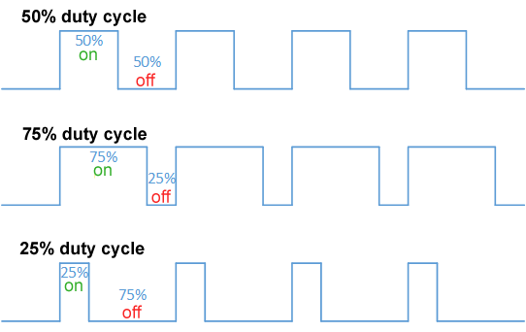
DUTY CYCLE
The term duty cycle describes the proportion of 'on' time to the regular interval or 'period' of time; a low duty cycle corresponds to low power, because the power is off for most of the time. Duty cycle is expressed in percent, 100% being fully on. When a digital signal is on half of the time and off the other half of the time, the digital signal has a duty cycle of 50%

Slide 5
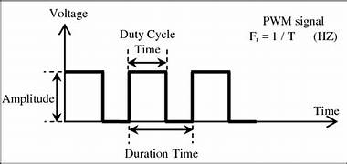
What is the frequency of a PWM signal?
Is the number of times per second that we repeat the on and off cycle

Slide 6
/* C code */

Slide 7

What I used from the course ?
I have used the
1-Dio session.
2-Timer session(TIMERS 2 [PWM & DC MOTOR & SERVO MOTOR] .
3-Lcd session.
That I have took at amit .

Slide 8
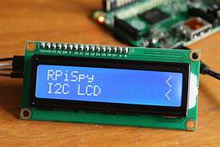
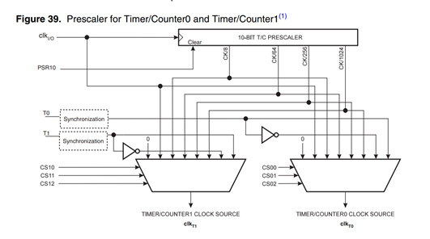
lcd
timer

Slide 9
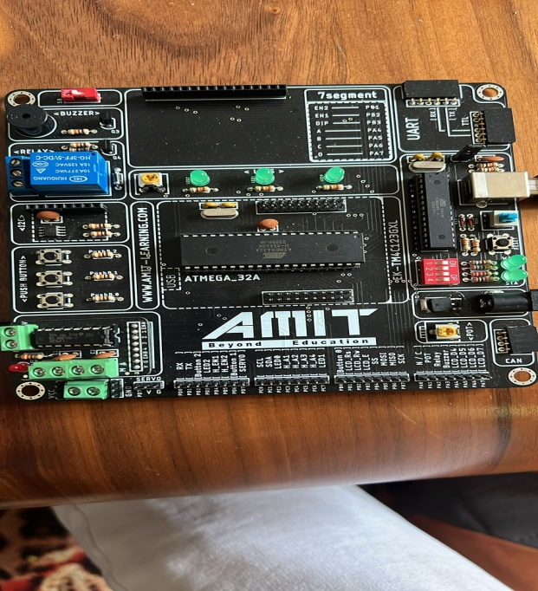
WHAT I HAVE USED (COMPONENT) ?
LCD
(Amit )ATMEGA 32

Slide 10
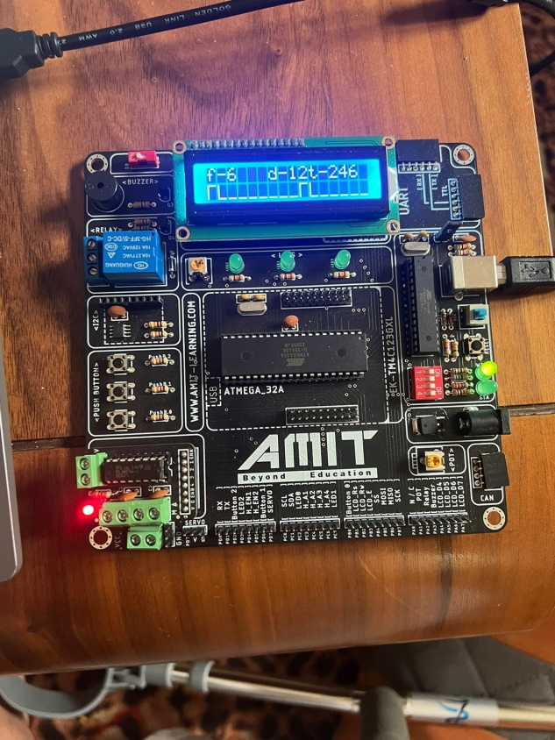
Result

Slide 11
Thank you

